Slide 1
EMPLOYEE RETENTION PREDICTION
A Machine Learning Approach to Optimize Talent Retention Strategies

Slide 2
Agendaa
Data Exploration and Pre-Processing
Project Objectives
Introduction
Model Development
Performance Evaluation
Conclusion & Future Scope
Feature Engineering

Slide 3

Introduction
Problem Statement
Organizations face challenges in identifying key factors that drive job change decisions among employees, especially in highly dynamic fields like data science. This lack of insight hampers their ability to implement effective retention strategies, leading to increased employee turnover, higher recruitment costs, and disruptions in productivity.
Approach
To address this challenge, we propose a machine learning-based solution that leverages predictive analytics to forecast the likelihood of job changes among data scientists, empowering HR teams to implement proactive retention strategies.
Imagine…

Slide 4
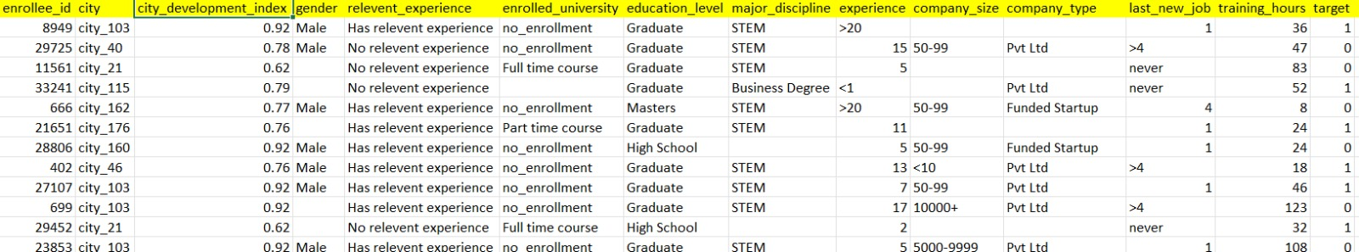
Data Overview:
The dataset contains 19,158 records, with each record representing an individual employee’s data.
Target Variable: The target variable is Target.
0 indicates the employee is not looking for a job change.
1 indicates the employee is looking for a job change.
Sample Data:

Slide 5

Understanding Data : A Exploration
Data Cleaning
Handling Missing Values:
Identified missing values using isnull().sum() to determine their extent across features.
Imputed numerical features using mean/median and categorical features with the most frequent value or "Unknown.".
Outlier Detection and Treatment:
Detected outliers using box plots and statistical methods (e.g., IQR).
IQR = Q3 (75th percentile) - Q1(25th percentile)
Treated outliers by capping extreme values to upper/lower boundaries.
Removing Duplicates:
Ensured data uniqueness using .drop_duplicates() , if any duplicates found.
Removing space before and after values: df.columns = df.columns.str.strip()

Slide 6
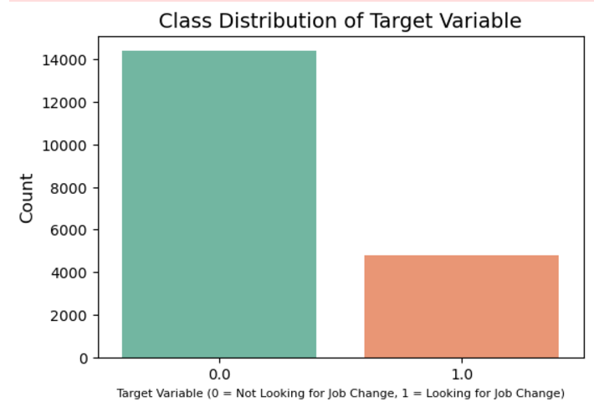
The bar chart visualizes the distribution of job change intentions. A higher number of employees are not looking for a job change, indicating class imbalance. This imbalance could bias the model, making it more likely to predict the majority class. Techniques like resampling or class weighting should be employed to correct this.
Class Imbalance in Target Variable
Notes:
Introduction: Briefly introduce the concept of class imbalance in the context of your project.
Example Text: "The target variable indicates whether an employee is looking for a job change (1) or not (0). A class imbalance is evident, where one class is significantly more frequent than the other, which can impact model performance."
Example Text:
"The dataset exhibits a significant class imbalance with the majority of employees not seeking job changes (Class 0)."
"This imbalance needs to be addressed during model training to ensure the model does not favor the majority class."
Addressing the Imbalance: Briefly mention the steps you will take or have taken to handle the imbalance in your model (if applicable).
Example Text: "To address this imbalance, techniques like SMOTE (Synthetic Minority Over-sampling Technique) or class weighting may be implemented during model training to improve the predictive accuracy for the minority class."

Slide 7
To address this issue (class imbalance) , used smote.
SMOTE for Class Imbalance:
SMOTE (Synthetic Minority Over-sampling Technique) was used to balance the dataset by generating synthetic samples for the minority class, addressing the class imbalance.
This step was crucial to ensure that the model doesn’t favor the majority class.
SMOTE improves the model’s ability to predict the minority class and avoids biasing the model towards the majority class.

Slide 8
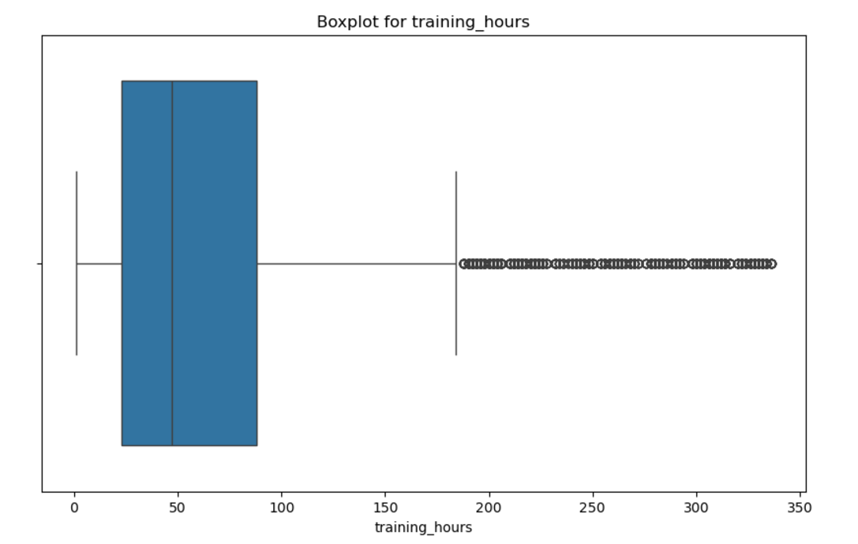
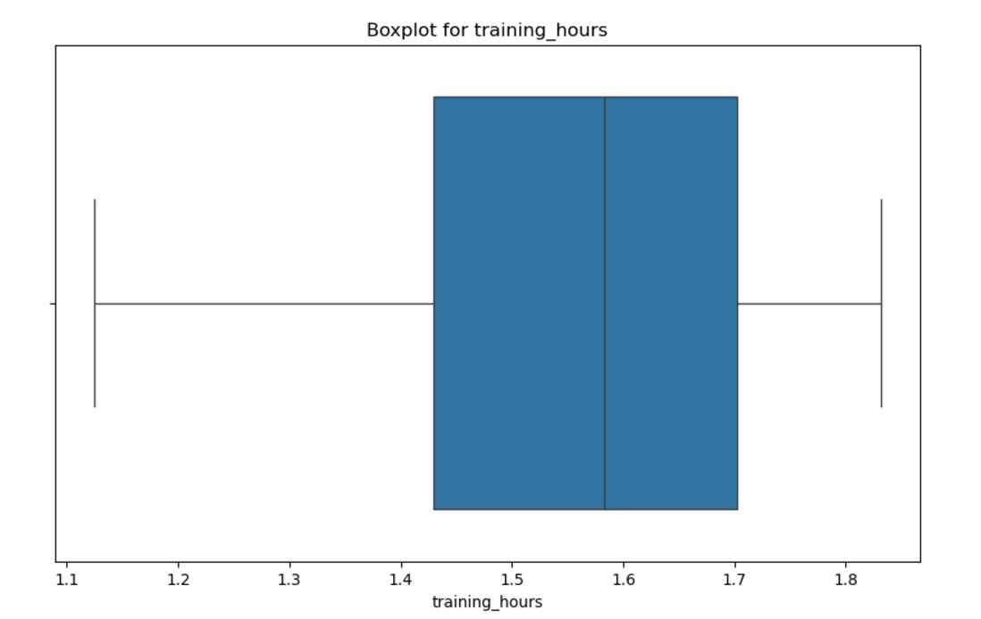
Outlier before capping and log transformation
Why we cap outliers instead of removing it?
Risk: Removal may distort the dataset by eliminating edge cases that could be meaningful.
Capping → adjusts extreme values to a specified limit, preserving all data points, while removal discards outliers entirely, reducing the risk of losing valuable information.
Log Transformation → Reduces skewness and compresses the range of values, particularly effective for highly right-skewed data.
Combined Effect → Applying capping before log transformation avoids extreme outliers having an outsized effect on the logarithmic scale, making the log transformation more meaningful.
Outlier after capping and log transformation

Slide 9

Statistical Test Results - Insights on Job Change Predictors
ANOVA Test Results (for numerical vs categorical features):
City Development Index: p-value = 0.000000 (strong significant relationship with job change)
Training Hours: p-value = 0.002820 (significant relationship with job change).
CHI-SQUARE Test Results (for categorical vs categorical features):
Education Level: Chi2 = 207.14, p-value => 0.000 (strong relationship with job change).
Experience: Chi2 = 592.13, p-value => 0.000(strong relationship with job change).
Last New Job: Chi2 = 191.82, p-value => 0.000(strong relationship with job change).
Company Size: Chi2 = 118.84, p-value => 0.000(significant relationship with job change).
Relevant Experience: Chi2 = 88.51, p-value => 0.000(strong relationship with job change).
Notes:
The ANOVA test was applied to examine the relationship between numerical features and job change likelihood. The p-values indicate significant relationships between the following variables and job change decisions.“ The results from the statistical tests and visualizations reveal several key factors that are statistically significant in predicting job change. These include work experience, education level, company size, and last new job. As a result, these features will play an important role in the feature selection for the prediction model

Slide 10

Pre-Processing the features
Label Encoding can be useful for ordinal data, where the categories have a meaningful order, and the algorithm can leverage this order (e.g., higher values imply higher education levels or better size).
Used when the categorical variable is ordinal (i.e., there is a natural order among categories), such as "Education Level" (High School< Bachelor’s< Master’s< PhD), or "Size" (Small< Medium< Large).
One-Hot Encoding is a method where categorical variables are converted into a series of binary (0 or 1) columns. Each column represents a unique category.
Used when the categorical variable is nominal (i.e., no order or ranking among categories), such as "Gender" (Male/Female), "City" (New York, Los Angeles, Chicago), etc.
Reason to use : Avoids Implicit Ordering , Scalable to Multiple Categories

Slide 11
Standardization and imputation of missing values
Standardization (Standard Scaler): This transforms the data to have a mean of 0 and a standard deviation of 1, which is useful for many algorithms (e.g., Logistic Regression, SVM).
from sklearn.preprocessing import StandardScaler
Imputation: replace missing values with a suitable strategy.
→ mean, median, or mode for numerical data, and the most frequent value or a placeholder for categorical data.
from sklearn.impute import SimpleImputer
imputer = SimpleImputer(strategy='mean')

Slide 12
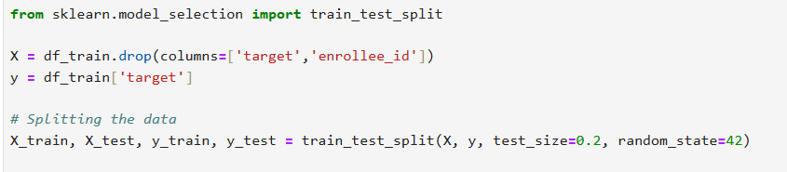
Train and test split
Test size → Divides the data into 80% training and 20% testing.
X and y → Features and target variable.

Slide 13
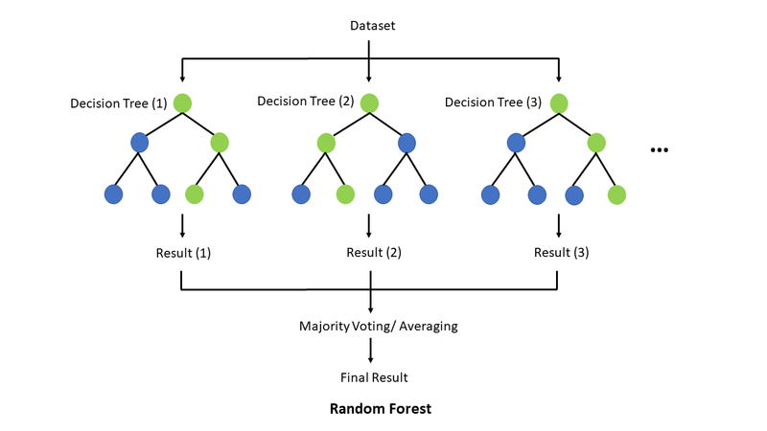
What is Random Forest? Why Random Forest for This Problem?
A Random Forest Classifier is an ensemble learning method that combines multiple decision trees to create a more accurate and robust predictive model.
Key points that made me chose:
Imbalanced dataset with a larger proportion of class 0 (non-target) compared to class 1 (target).
Features of mixed types (categorical and numerical).
Potential presence of outliers and noise in the data.
How Random forest works?
Bootstrapping: Randomly samples data points (with replacement) to create multiple training subsets.
Tree Construction:
Each tree is trained on a different subset.
At each split, a random subset of features is selected (ensuring diversity)
Prediction:
In our case, for classification, the final prediction is the majority vote across all trees.

Slide 14
Dealing with Imbalanced Classes (Target class (1) is underrepresented.)
Used class weight='balanced' to penalize misclassification of minority class.
Applied SMOTE to generate synthetic samples and avoid overfitting.
Handling Noise and Outliers (Noisy features or outliers can skew predictions.)
Random Forest trains each tree on a random data subset, reducing outlier influence.
Majority voting minimizes noise impact on final predictions.
Evaluation Metrics Show Consistency (Consistent performance on unseen data)
Stratified K-Fold Cross-Validation ensures reliability across splits.
Test predictions on unseen 2,129 samples show strong generalization.
How Random forest handled it?

Slide 15
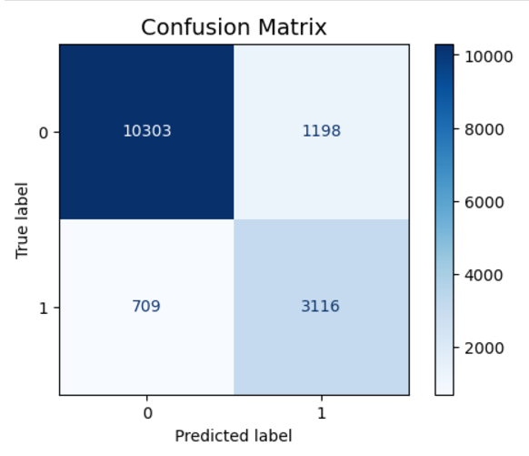
1. Accuracy
80%: Indicates the overall correctness
of the model.
2. ROC-AUC Score
80%: Reflects the model’s ability to distinguish
between the majority (Class 0) and
minority (Class 1) classes effectively.
3. Overall Performance (Weighted Average):
Precision: 81%, Recall: 80%, F1-Score: 80%
Balances metrics across both classes, accounting for imbalances.
Model Evaluation

Slide 16
Dataset Size:
2,129 rows with no target variable.
Similar structure to the training data but without the target column.
Preprocessing:
The same preprocessing steps (encoding, scaling, and handling missing values) applied to the training data were also applied to this test dataset.
Ensured consistency between the training and test data for accurate predictions.
Feature Transformation:
The features were scaled and encoded to match the transformations performed on the training set (e.g., using LabelEncoder for categorical features).
Test data overview

Slide 17
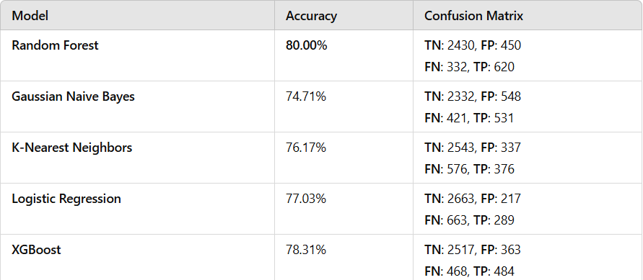
Model Comparison: Random Forest vs Other Algorithms
→ Random Forest leads with the highest accuracy (80%), indicating superior generalization on the test data.
→ Despite other models (like Logistic Regression and XGBoost) show competitive performance, Random Forest shows better overall consistency and robustness, particularly in handling class imbalances.

Slide 18
Random Forest: Best Performer
Achieved 79.59% accuracy with a ROC-AUC score of 79.75%, outperforming all other models.
Demonstrated robustness against imbalanced data and noise through techniques like SMOTE and class_weight='balanced'.
Confusion Matrix (Test Data): TN: 2430, FP: 450 | FN: 332, TP: 620.
Other Models Evaluated:
Logistic Regression, K-Nearest Neighbors, Gaussian Naive Bayes, and XGBoost fell short in terms of accuracy and handling minority class recall.
Example: Logistic Regression accuracy (77.03%) with a recall of 30.36% for the minority class.
Why Random Forest Excels?
Generalization:
Consistent performance across Stratified K-Fold cross-validation (80% ± 0.0).
Predicted unseen test data effectively, validating real-world applicability.
Robustness:
Reduced impact of outliers and noise through ensemble averaging.
Majority voting ensured accurate classification despite individual tree errors.

Slide 19

Business Impact
Cost Savings
Reducing attrition can save up to 50%-200% of an employee’s annual salary, which is the typical cost of replacing an employee.
Improved Workforce Planning
Predictive insights enable HR teams to design better hiring, training, and retention strategies.
Increased Employee Engagement
Addressing attrition drivers fosters a more engaged workforce, leading to higher productivity and morale.
Enhanced Competitive Edge
Proactively retaining top talent helps maintain business continuity and reduces disruptions caused by turnover.

Slide 20
Thank you very much!

